Slide 1
Deep Learning
Week 8

Slide 2
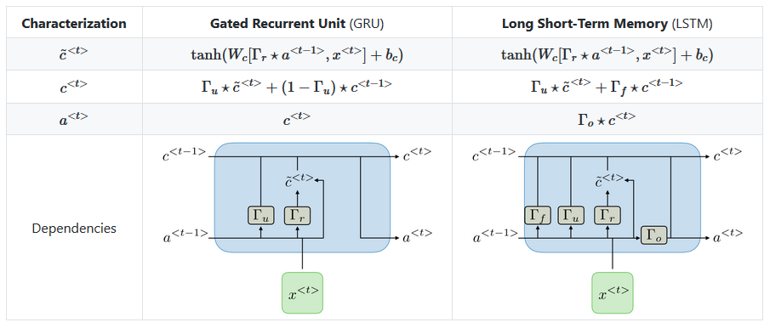
Objectives
RNN – class of ANN designed to recognize a data's sequential characteristics and use patterns to predict the next likely scenario
GRU – Gradient Recurrent Unit – deal with vanishing gradient descent problem
LSTM – Long Short-Term Memory – generalization of GRU

Slide 3
Time series
Time series model is about the idea that past behavior and patterns can be used to predict future behavior.
Time step may be of a series of any length, for example: seconds, hours, days, years etc.
A recurrent neural network deals with sequence problems because their connections form a directed cycle.

Slide 4
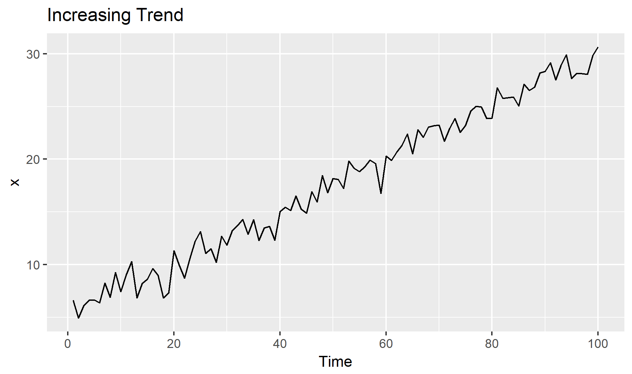
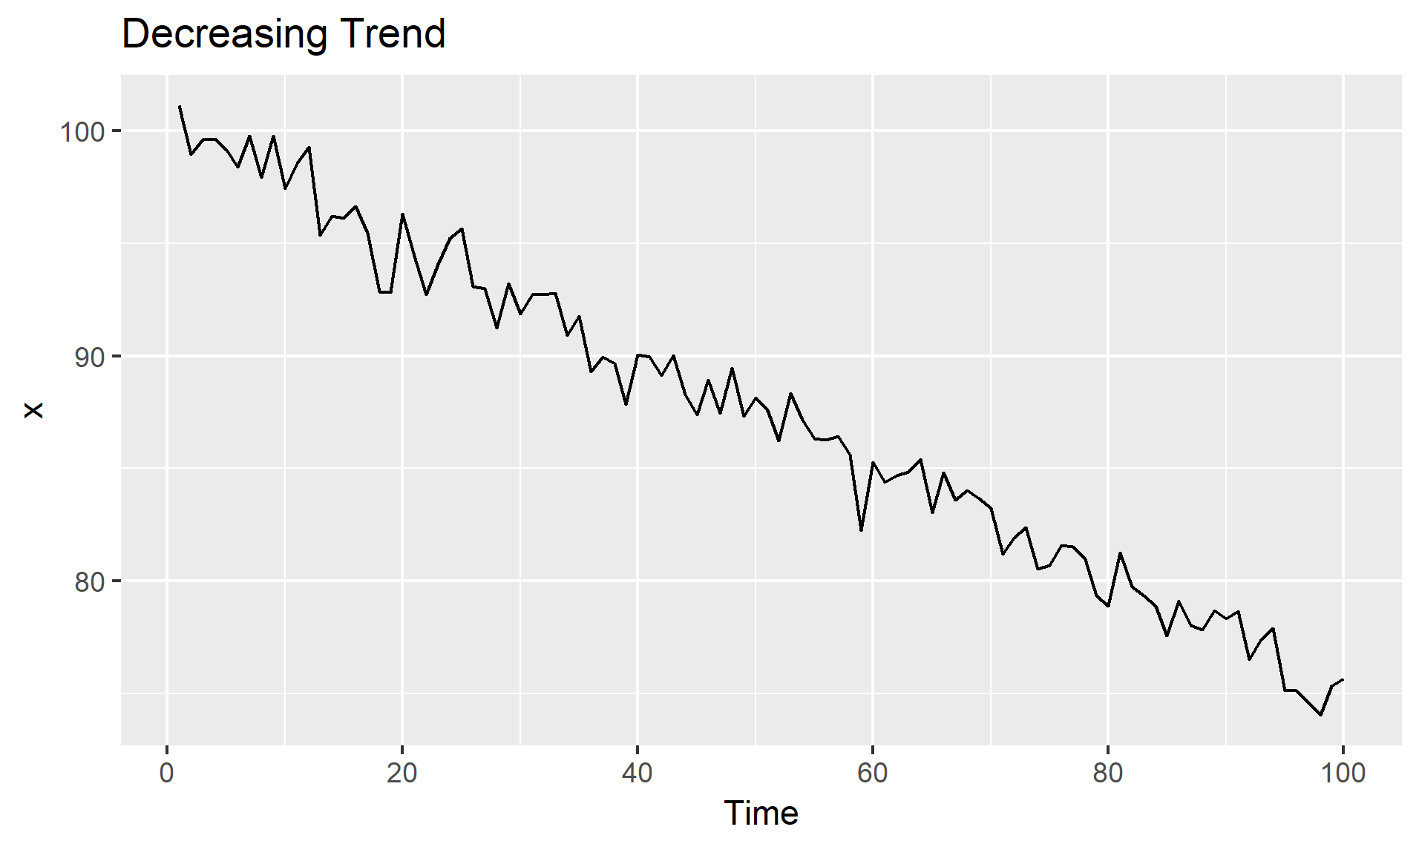
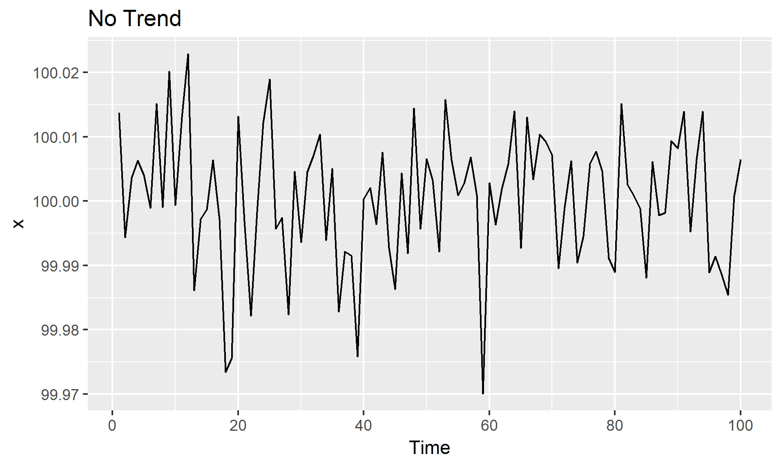
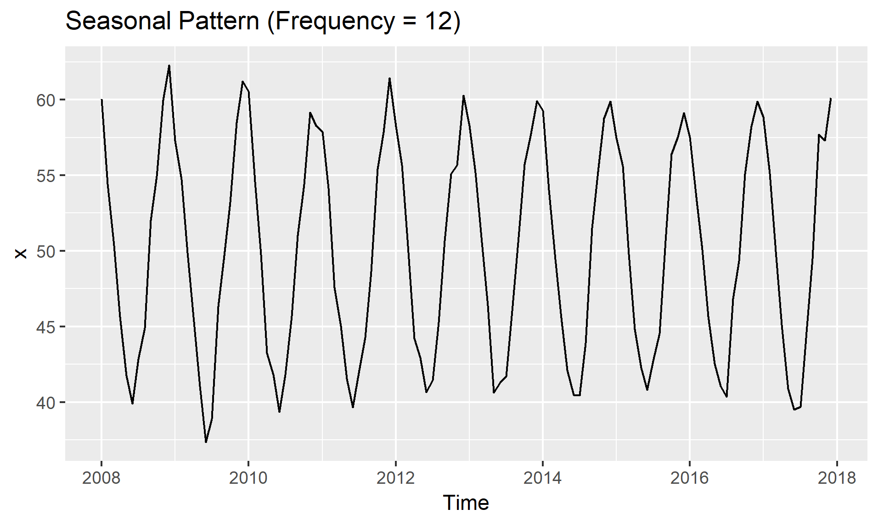
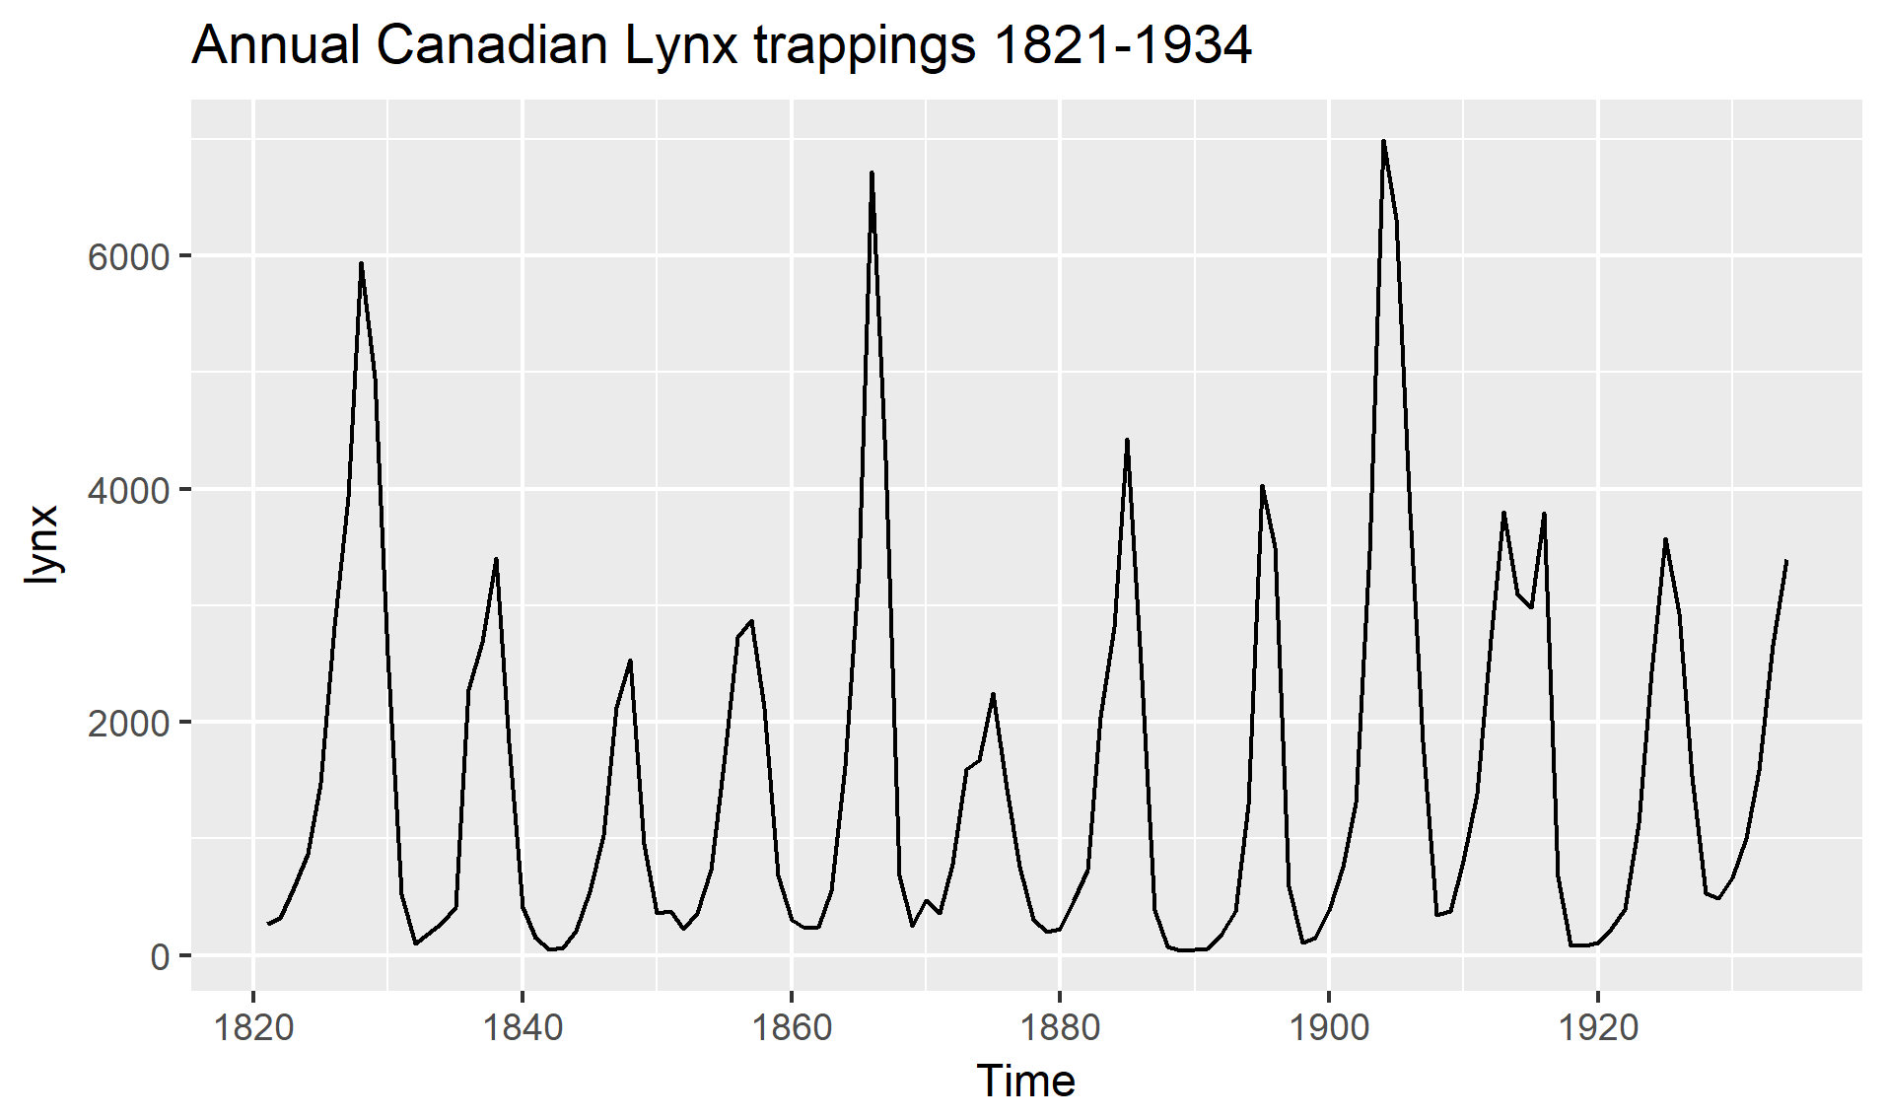
Time series components
Trend: A trend exists when a series increases, decreases, or remains at a constant level with respect to time. Therefore, the time is taken as a feature.
Seasonality: This refers to the property of a time series that displays periodical patterns that repeats at a constant frequency (m).
Cycles: Cycles are seasons that do not occur at a fixed rate.

Slide 5
Limitations
Limitation of Vanilla Neural Networks (and Convolutional Networks)
Their API is too constrained: they accept a fixed-sized vector as input (e.g. an image) and produce a fixed-sized vector as output (e.g. probabilities of different classes).
These models perform this mapping using a fixed amount of computational steps (e.g. the number of layers in the model).
They do not care on the sequence of the input data and as result the eventual pattern on the sequence of data.
RNN is a class of neural networks that deals the sequential data (introduced in late 80’s).
Deep neural networks provide learning via depth in layers.
RNNs are going deep in time. they share weights and biases across time steps.
The birds are flying in the …

Slide 6
Recurrent Neural Network — RNN
Traditional neural networks assume that all inputs are independent of each other.
Their input and outputs are also fixed dimensions
RNN is a class of neural networks that deals the sequential data (introduced in late 80’s).
Time series (stock price, sales)
Natural language
Sound, music and audio information
Car trajectory

Slide 7
Recurrent Neural Network — RNN
DNNs are deep in layers. RNNs are deep in time (in addition), Shared weights and biases across time steps.
The birds are flying in the …
Use case:
speech recognition
language modeling
machine translation
sentiment analysis
image captioning,…

Slide 8
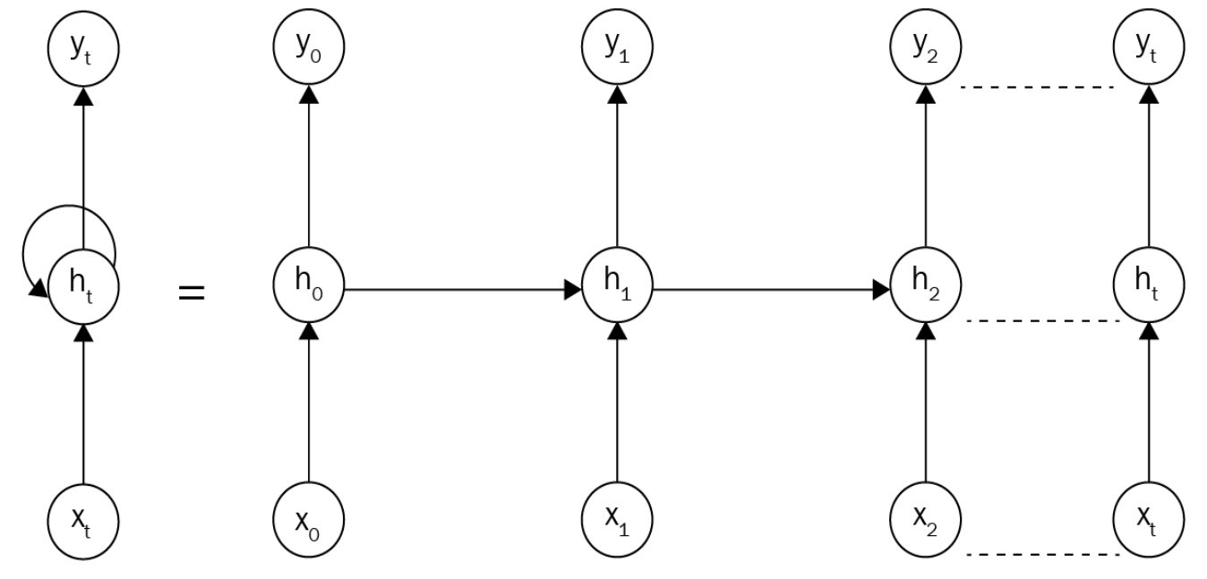
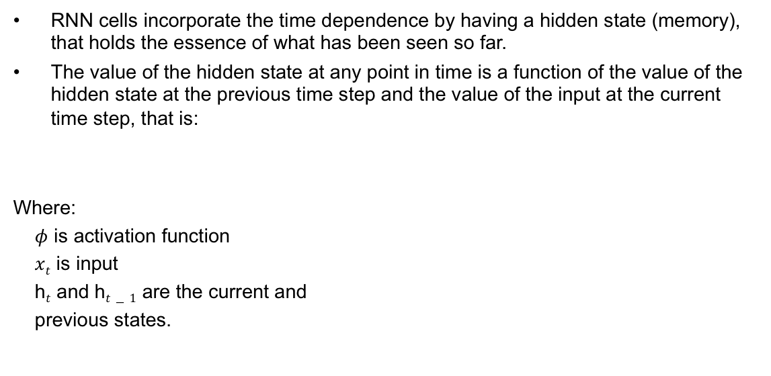
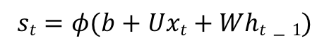
Recurrent Neural Network — RNN
RNN cells incorporate the time dependence by having a hidden state (memory), that holds the essence of what has been seen so far.
The value of the hidden state at any point in time is a function of the value of the hidden state at the previous time step and the value of the input at the current time step, that is:
Where:
$φ$ is activation function
$xt$ is input
h$t$ and h$t−1$ are the current and
previous states.
$$st=φ(b+Uxt+Wht−1)$$

Slide 9
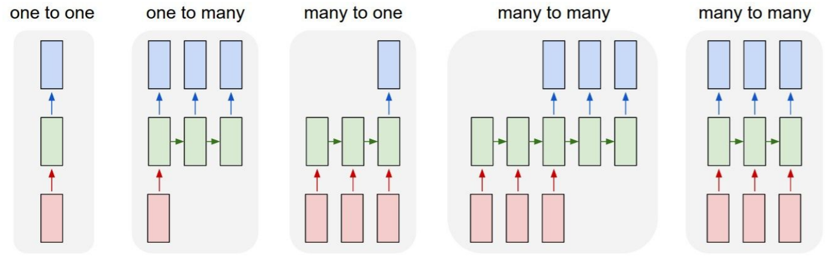
Recurrent Neural Networks
Vanilla Neural Networks
Image Captioning
Sentiment classification
Machine Translation
Video processing

Slide 10
Recurrent Neural Networks
Vanilla mode of processing without RNN, from fixed-sized input to fixed-sized output (e.g. image classification).
Sequence output (e.g. image captioning takes an image and outputs a sentence of words).
Sequence input (e.g. sentiment analysis where a given sentence is classified as expressing positive or negative sentiment).
Sequence input and sequence output (e.g. Machine Translation: an RNN reads a sentence in English and then outputs a sentence in French).
Synced sequence input and output (e.g. video classification where we wish to label each frame of the video).

Slide 11
Recurrent Neural Networks
Sequence input (e.g. sentiment analysis where a given sentence is classified as expressing positive or negative sentiment).

Slide 12
Recurrent Neural Networks
Sequence input and sequence output (e.g. Machine Translation: an RNN reads a sentence in English and then outputs a sentence in French).
we can split the network into multiple RNNs, each of which specializes in one task. In this example, we would use an “encoder” network that reads in the English (blue) and a separate “decoder” network that reads in the French (orange):

Slide 13
RNN limits
Vanishing gradient
The vanishing gradient problem is when the gradient shrinks as it back propagates through time.
If a gradient value becomes extremely small, it doesn’t contribute too much learning.
Short-term memory
If a sequence is long enough, they’ll have a hard time carrying information from earlier time steps to later ones.
So if you are trying to process a paragraph of text to do predictions, RNN’s may leave out important information from the beginning.

Slide 14
LSTM
By manipulating few gates a recurrent network is able to remember what is needs and for what is no longer useful.
The LSTM cells exist between the time steps in the network’s flow.
t=0
t=1
t=2
LSTM
LSTM
RNN
RNN
RNN

Slide 15
LSTM-Use Selectivity to control
The key to overcoming the fundamental challenge of LSTMs and keeping our state under control is to be selective in three things:
what we write,
what we read (because we need to read something to know what to write),
and what we forget (because obsolete information is a distraction and should be forgotten).

Slide 16
LSTM
RNN Output
Write gate
Read gate
Information cell
Keep gate
Input Gate
Output Gate

Slide 17
LSTM(prototype)- Gates as a mechanism for selectivity
These decisions will be set by taking advantage of state-sized read, write and forget vectors with values between 0 and 1 specifying the percentage of reading, writing and forgetting.
The logistic sigmoid is a natural choice since it is differentiable and produces continuous values between 0 and 1.
These read, write and forget vectors are called “gates”,
i_{t} :The input gate (for writing)
o_{t} : The output gate (for reading)
f_{t} : The forget gate (for remembering).
The forget gate is used for forgetting, but it actually operates as a remember gate. E.g., a 1 in a forget gate vector means remember everything, not forget everything.

Slide 18
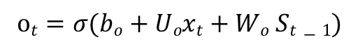
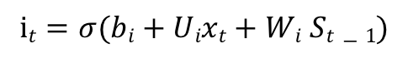
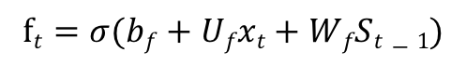
LSTM (prototype)- Gates as a mechanism for selectivity
Here are the mathematical definitions of the gates, where s indicate the state.
$$it=σ(bi+Uixt+Wi St−1)$$
$$ot=σ(bo+Uoxt+Wo St−1)$$
$$ft=σ(bf+Ufxt+WfSt−1)$$

Slide 19
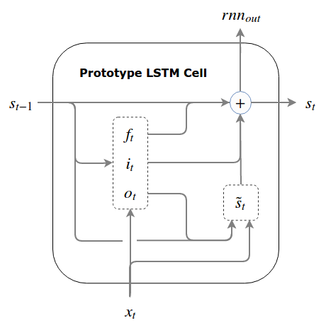
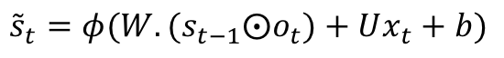
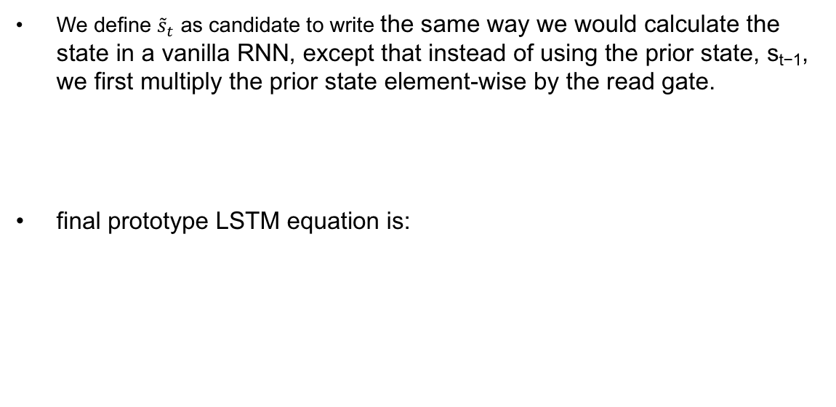
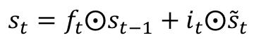
LSTM (prototype)- Glue Gates together
We define ${\tilde{s}}_{t}$ as candidate to write the same way we would calculate the state in a vanilla RNN, except that instead of using the prior state, s_{t−1}, we first multiply the prior state element-wise by the read gate.
final prototype LSTM equation is:
$${\tilde{s}}_{t}=φ(W.{(s}_{t−1}⨀o_{t})+Ux_{t}+b)$$
$$s_{t}=f_{t}⨀s_{t−1}+i_{t}⨀{\tilde{s}}_{t}$$

Slide 20
Normalized prototype
The state, which is used to compute both the gates and the candidate write can grow unbounded.
Solution:
Pseudo LSTM
GRU

Slide 21
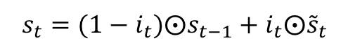
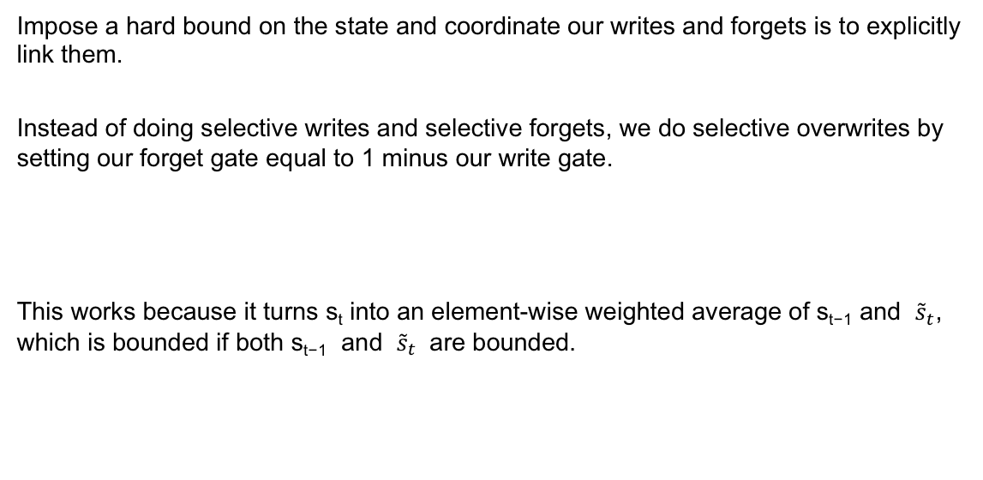
GRU
Impose a hard bound on the state and coordinate our writes and forgets is to explicitly link them.
Instead of doing selective writes and selective forgets, we do selective overwrites by setting our forget gate equal to 1 minus our write gate.
This works because it turns s_{t} into an element-wise weighted average of s_{t−1} and ${\tilde{s}}_{t}$, which is bounded if both s_{t−1} and ${\tilde{s}}_{t}$ are bounded.
$$s_{t}={(1−i}_{t})⨀s_{t−1}+i_{t}⨀{\tilde{s}}_{t}$$

Slide 22
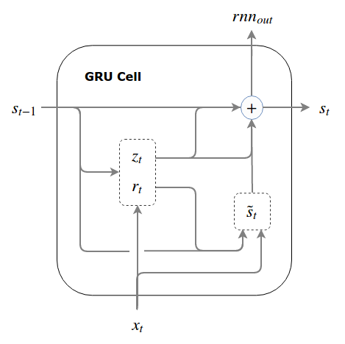
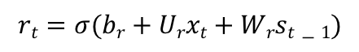
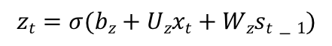
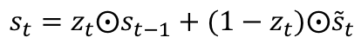
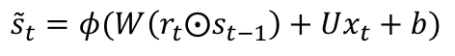
GRU
To conform for the GRU terminology used in the literatures, we call the overwrite gate an update gate and label it z_{t.}
Note that although called an “update” gate, it operates as “do-not-update” gate by specifying the percentage of the prior state that we don’t want to overwrite.
$$rt=σ(br+Urxt+Wrst−1)$$
$$zt=σ(bz+Uzxt+Wzst−1)$$
$${\tilde{s}}_{t}=φ(W\left(r_{t}⨀s_{t−1}\right)+Ux_{t}+b)$$
$$s_{t}=z_{t}⨀s_{t−1}+(1−z_{t})⨀{\tilde{s}}_{t}$$

Slide 23
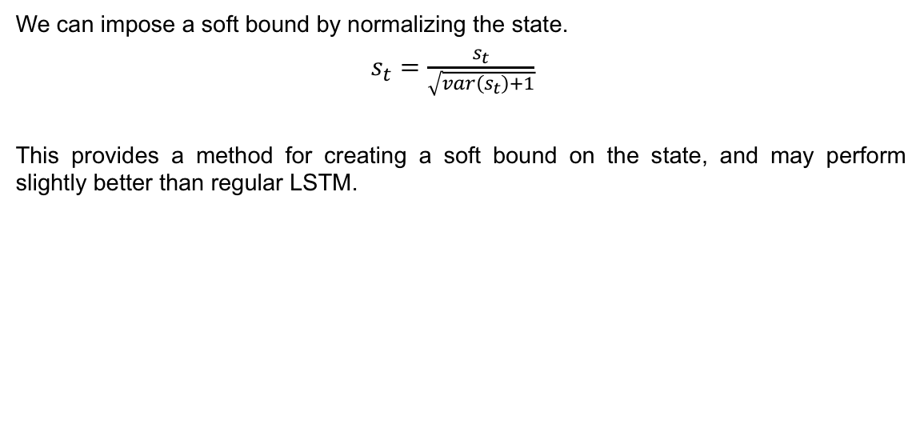
Pseudo LSTM-soft boundaries
We can impose a soft bound by normalizing the state.
$s_{t}=\frac{s_{t}}{\sqrt{var\left(s_{t}\right)+1}}$
This provides a method for creating a soft bound on the state, and may perform slightly better than regular LSTM.

Slide 24
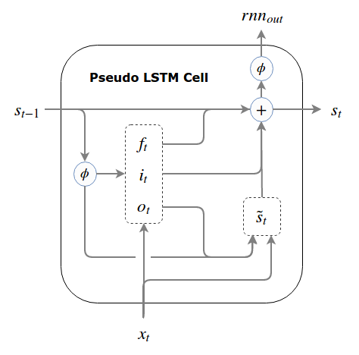
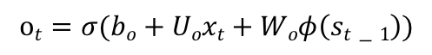
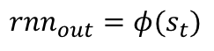
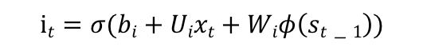
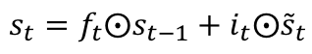
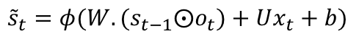
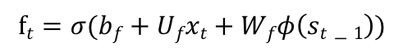
Pseudo LSTM-hard boundaries
we cannot apply the squashing function to the state itself (for this would result in information morphing and violate our fundamental principle of LSTMs). Instead, we pass the state through the squashing function every time we need to use it for anything except making incremental writes to it.
$$it=σ(bi+Uixt+Wiφ\left(st−1\right))$$
$$ot=σ(bo+Uoxt+Woφ\left(st−1\right))$$
$$ft=σ(bf+Ufxt+Wfφ\left(st−1\right))$$
$${\tilde{s}}_{t}=φ(W.{(s}_{t−1}⨀o_{t})+Ux_{t}+b)$$
$$s_{t}=f_{t}⨀s_{t−1}+i_{t}⨀{\tilde{s}}_{t}$$
$${rnn}_{out}=φ(s_{t})$$

Slide 25
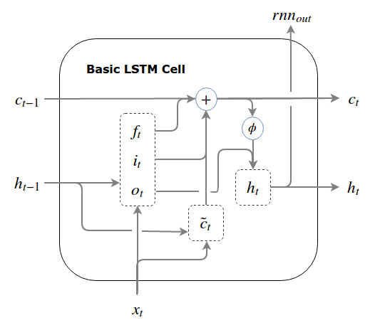
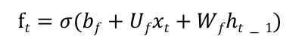
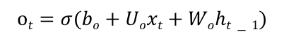
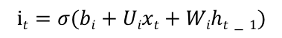
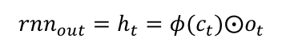
LSTM
Here we think of the state as being separate from the rest of the RNN cell
Rename the main state, s_{t}, to c_{t} (c is for cell)
We will also introduce a separate shadow state, h_{t} (h is for hidden state)
A real LSTM can be summarized as below
$${h_{t−1}=φ(c}_{t−1})⨀o_{t−1}$$
$$it=σ(bi+Uixt+Wiht−1)$$
$$ot=σ(bo+Uoxt+Woht−1)$$
$$ft=σ(bf+Ufxt+Wfht−1)$$
$${\tilde{c}}_{t}=φ(W.h_{t−1}+Ux_{t}+b)$$
$$c_{t}=f_{t}⨀c_{t−1}+i_{t}⨀{\tilde{c}}_{t}$$
$${{rnn_{out}=h}_{t}=φ(c}_{t})⨀o_{t}$$

Slide 26
Activation functions for Time series LSTM
Here Relu is not an option because we would like to have increase and decrease both in the state.
Sigmoid
This is used as the gating functions for the gates(in, out, forget) since it outputs a value between 0 and 1, it can either let no flow or complete flow of information throughout the gates.
Tanh
LSTMs manage an internal state vector whose values should be able to increase or decrease when we add the output of some function. Sigmoid output is always non-negative; values in the state would only increase. The output from tanh can be positive or negative, allowing for increases and decreases in the state.
To overcome the vanishing gradient problem, we need a function whose second derivative can sustain for a long range before going to zero. tanh is a suitable function with the above property. 𝑡𝑎𝑛ℎ(𝑥)=2⋅𝜎(2𝑥)−1

Slide 27
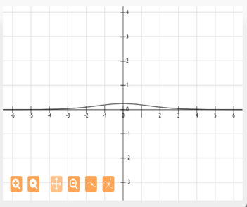
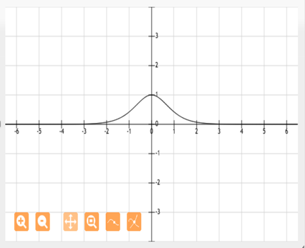
Activation functions Tanh vs sigmoid
Tanh has stronger gradients:
Tanh avoiding bias in the gradients. This is explained very well in the paper, and it is worth reading it to understand these issues.
For the data between -1, 1 we have:
Sigmoid Tanh

Slide 28
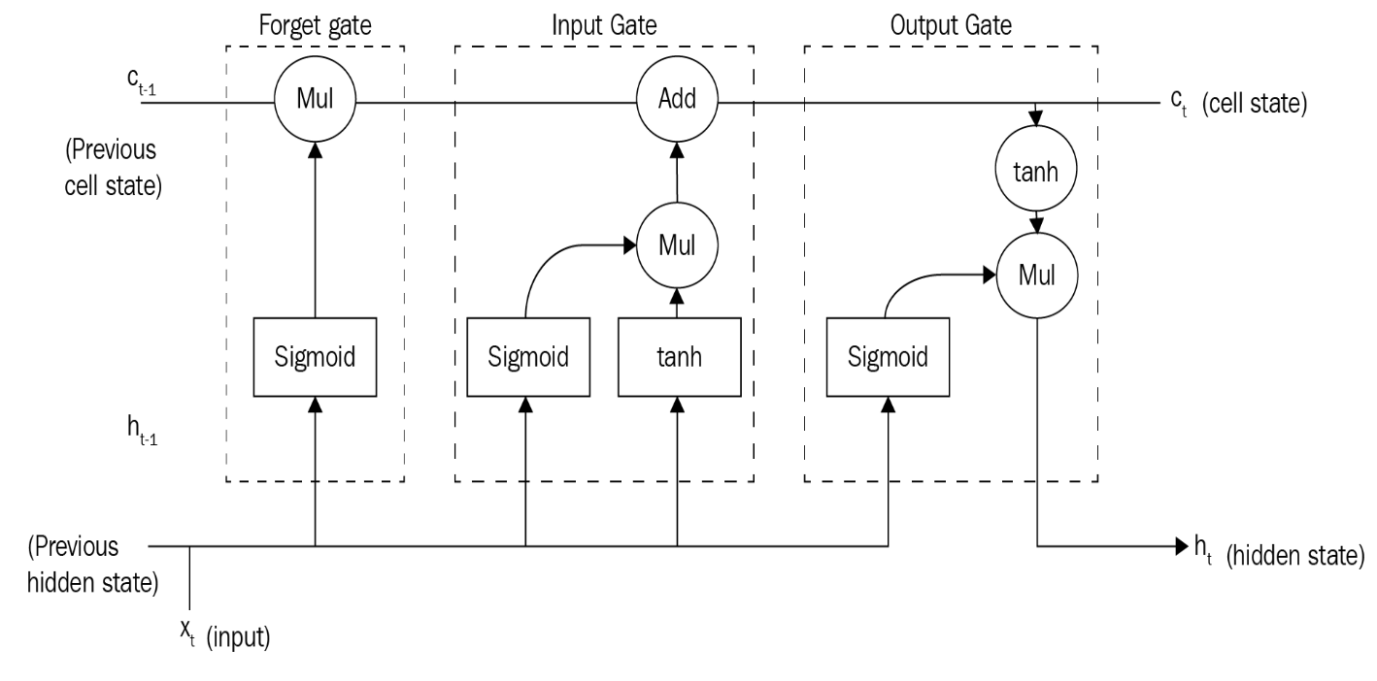
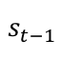
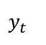
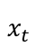
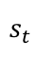
Long Short-Term Memory (LSTM)
$$s_{t−1}$$
$$s_{t}$$
$$x_{t}$$
LSTM
$$y_{t}$$

Slide 29
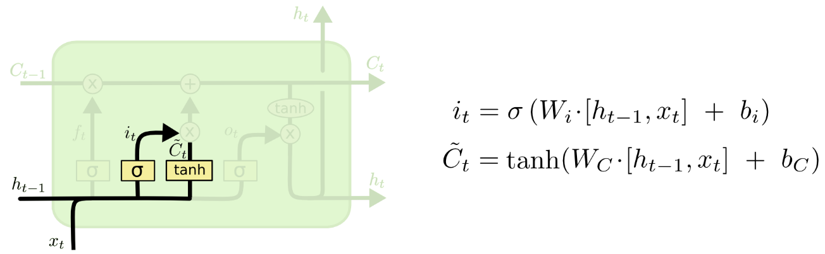
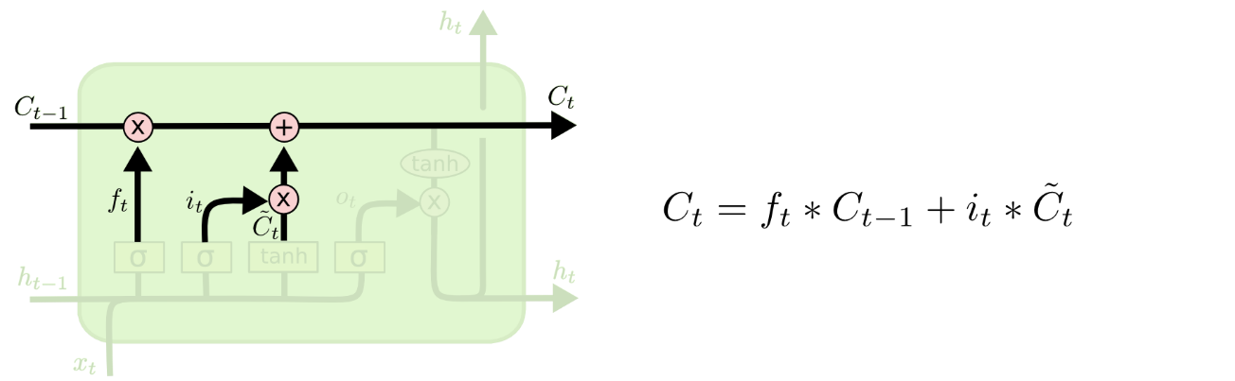
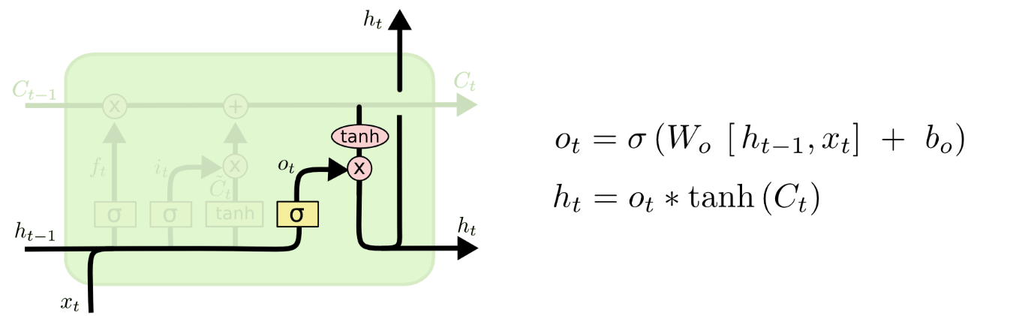
LSTM

Slide 30

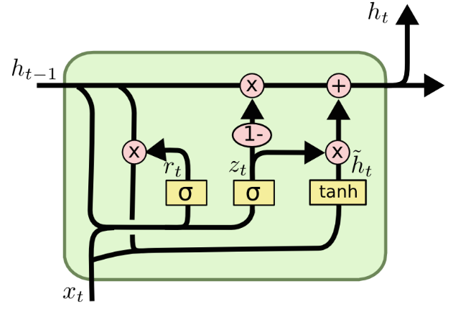





LSTM vs. GRU

Slide 31
LSTM vs GRU
There are few differences between LSTM and GRU
GRU has 2 gates: update gate z and reset gate 𝑟; LSTM has 3: input 𝑖, forget 𝑓, and output 𝑜
LSTM maintains an internal memory state c, while GRU doesn’t
LSTM applies a nonlinearity (sigmoid) before the output gate, GRU doesn’t
The performances are comparable in many tasks, according to Chung et al.

Slide 32
Normalization in Time series
Batch Normalization can not be used a recurrent neural network, as the statistics are computed per batch, this does not consider the recurrent part of the network. Weights are shared in an RNN, and the activation response for each "recurrent loop" might have completely different statistical properties.
Layer normalization is very common in time series neural network.

Slide 33
LSTM combined with CNN
Sequence output (e.g. image captioning takes an image and outputs a sentence of words).
The first stage is the vision understanding part, which learns a mapping between an image and semantic attributes through CNN.
The second stage is the language generation part, which learns a mapping from input attributes vector (red arrow) to a sequence of words through LSTM. In the end-to-end baseline mode, CNN features are input to the LSTM directly (blue dash arrow), without the attributes detector.

Slide 34
Recurrent Neural Networks
Deep neural networks and multimodal neural language model are used to learn both image and text jointly in a multimodal space.
The language generation part generates captions using the information from Step 1
Image Encoder
Input Image
Multimodal space
Language decoder
Generated capture
Language Encoder

